Slide 1
DYNAMIC REPRESENTATIONS
Building knowledge through an active representational process based on deep generative models
Juan Sebastian OLIER JAUREGUI
and Matthias RAUTERBERG

Slide 2
Where is meaning coming from?

Slide 3
Representations
Create knowledge by observing sequential data:
Making sense as a dynamic process
Representing as an active process
Unsupervised representation learning

Slide 4
Representations
Embodied
Context dependent
Dynamic
Flexible

Slide 5
Active Inference

Slide 6
Generative Models (GM)
Represent the state of the world by minimizing prediction error.

Slide 7
Temporal Relations in GM
t-1 t
Dynamically integrate information while interacting with the world

Slide 8
Problem: Confusion with Dynamic Content

Slide 9
Solution: Separate Process and Content

Slide 10
Content and Process
Process Temporal relations
Content
Sensory inputs
Different levels to encode the characteristics of data: the content and its process

Slide 11
Model
𝝅_{t-2}
𝝅_{t-1}
𝝅_{t}
a_{t-1}
a_{t}
a_{t+1}
z_{t-1}
z_{t}
z_{t+1}
x_{t-1}
x_{t}
x_{t+1}

Slide 12
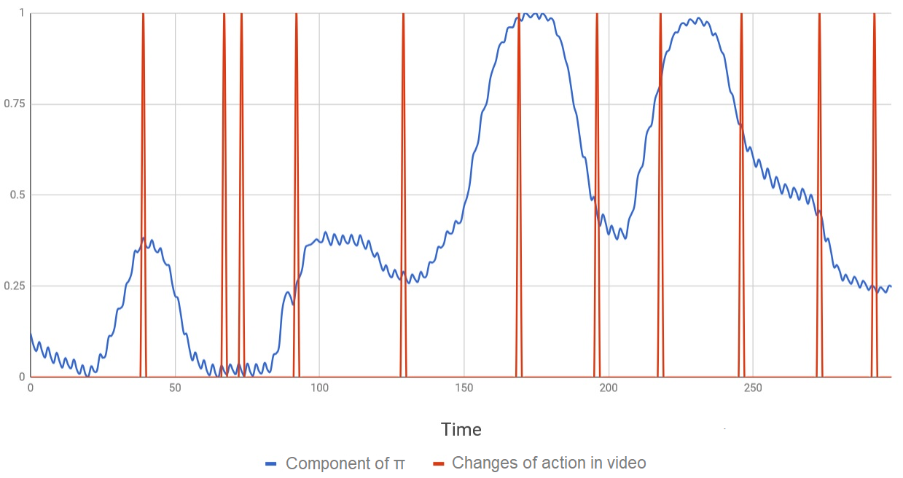

Slide 13
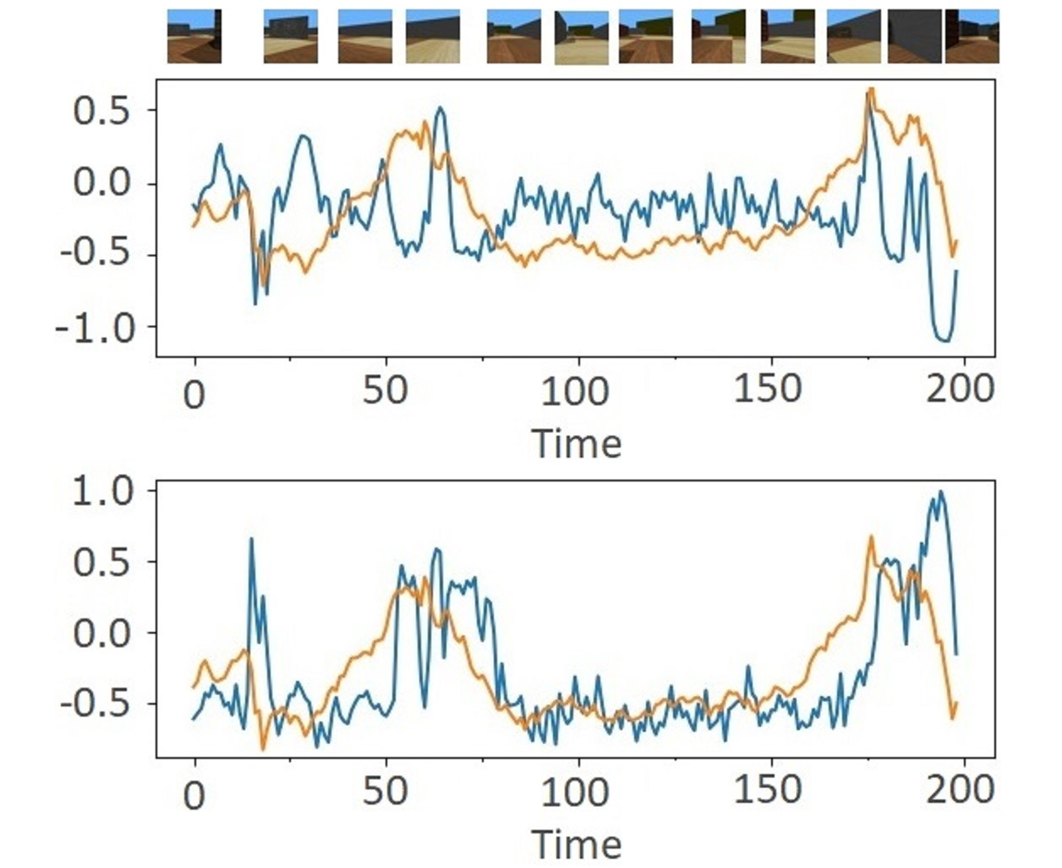
Blue line= differential speed of wheels
Orange line= values of PI
Blue line= values of A
Orange line= values of PI

Slide 14
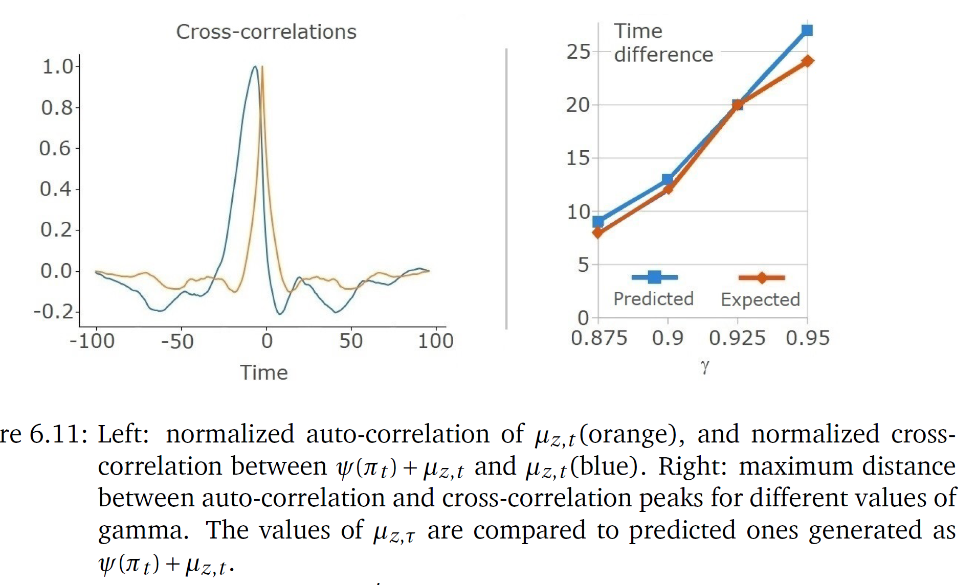
anticipation effect

Slide 15
Results
Unsupervised representation learning
Segment sequential data based on observed dynamics
Generative models merging deep learning and variational methods
Semantically interpretable representations

Slide 16
Conclusions
Build knowledge in an unsupervised way
Representing content and process yields interpretability
Prediction is central for representing dynamics
Learning from action-content relations links to Active Inference

Slide 17
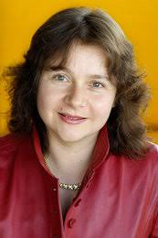
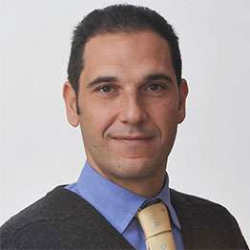
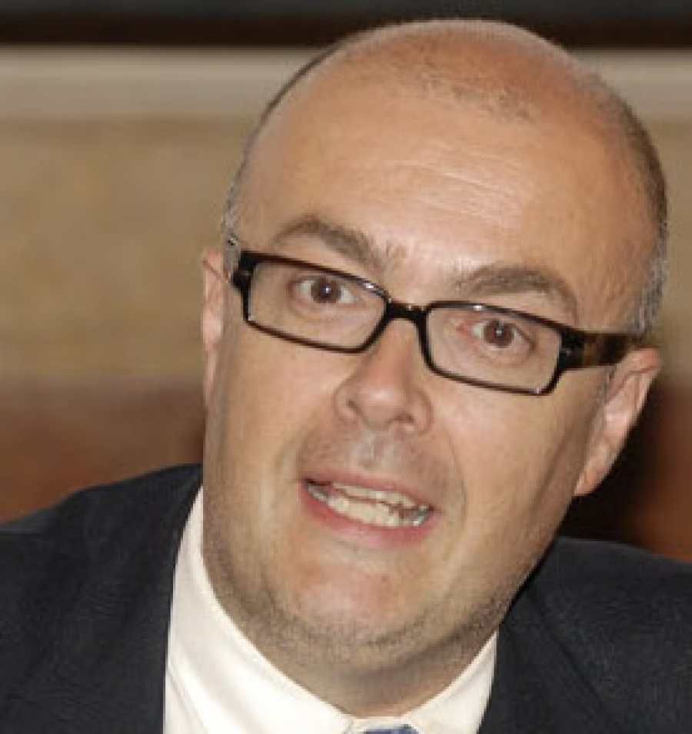
Sebastian OLIER
Emilia BARAKOVA
Lucio MARCENARO
Carlo REGAZZONI

